Slide 1
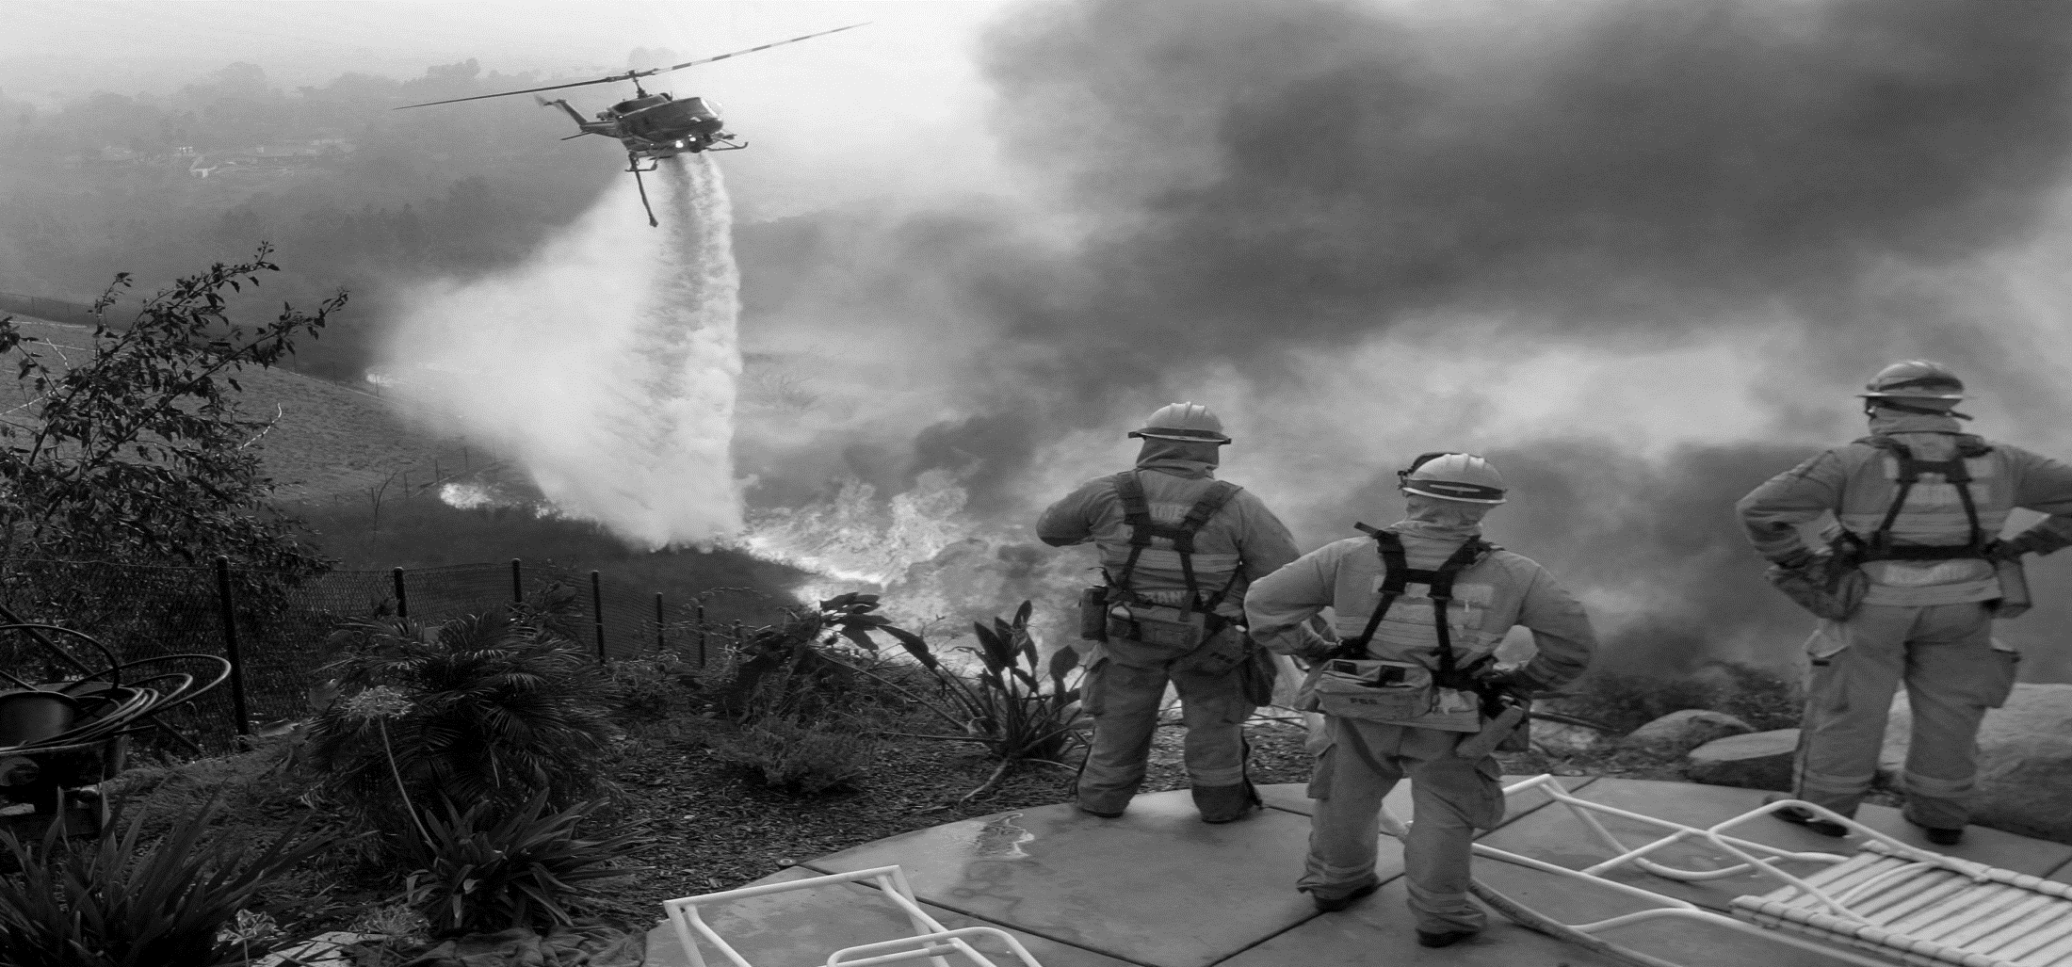
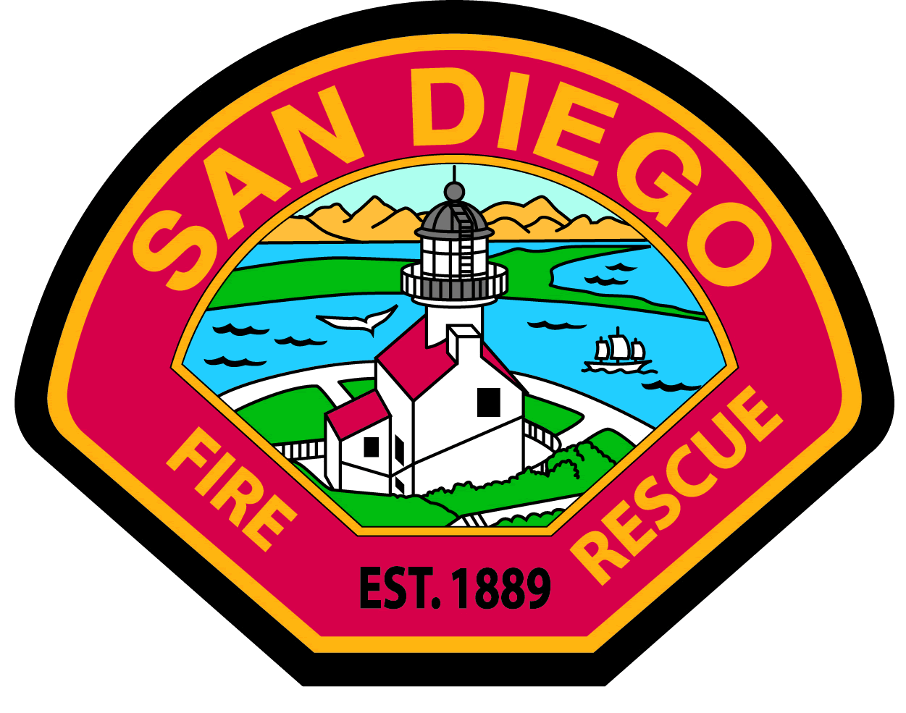
Ready – Be Ready Set – Understand the threat Go! – Act Early
[Insert your
Department
logo here]
Notes:
The RSG! Program implementation guide and the Your Role in Fire Adapted Communities guide can answer many questions. Feel free to contact RSG! Staff at 703.273.0911 / RSG@iafc.org if you have any questions or needs. We are happy to have you apart of the RSG! Program.

Slide 2
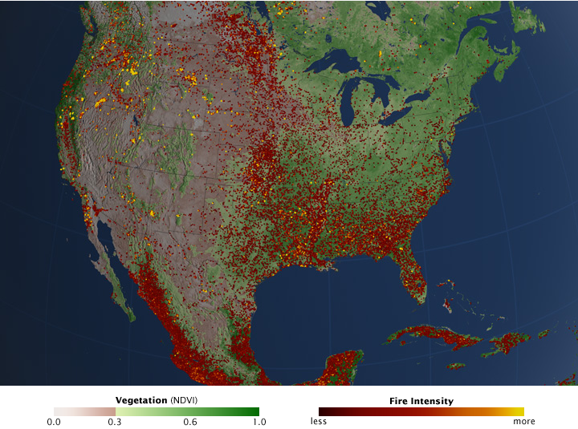
2012 Wildland Fire Frequency Mapping
Notes:
2012 wildland fire frequency mapping by USFS, NOAA and NASA.
Wildfire is a serious concern in this country – its not a question of if but when the next major wildland fire will occur. Through advance planning, understanding and preparation, we can all be partners in the wildfire fire solution.

Slide 3
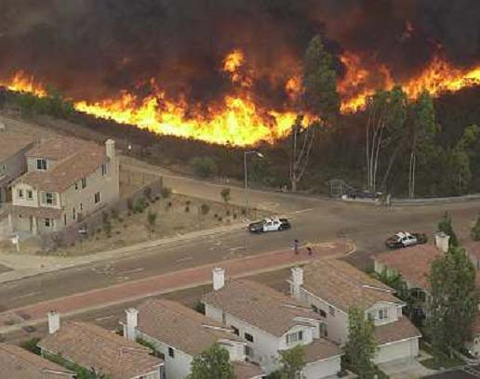
RSG! Program – Risk of “Wildland Fire”
“Wildland Urban Interface” (WUI)
500 linear miles within the City of San Diego
Cedar Fire 2003
Witch Creek Fire 2007
Bernardo Fire 2014
Notes:
Wildland-urban interface is where the back yards of homes meet dense stands of native-naturalized vegetation in canyons and other open space areas.
The City of San Diego has over 500 linear miles of WUI.
We often think of San Diego’s wildland fire threat as the areas in the eastern edges of the city. The Cedar and Witch Creek fires both started in East County and spread into the City.
But our canyons run throughout the city and a fire could start in anyone of them and spread to the houses on the canyon rim.

Slide 4
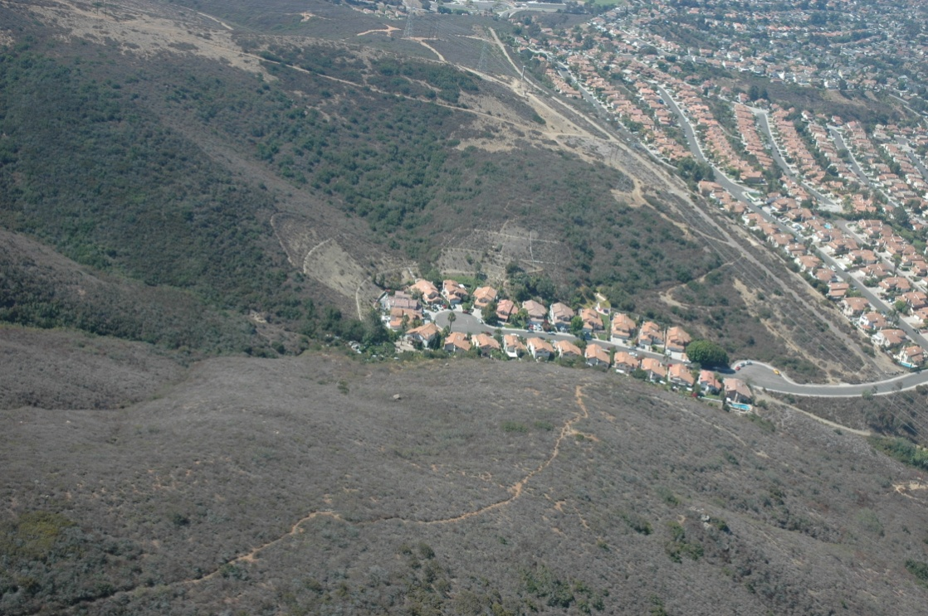
Open Space Islands
Relatively Small Pockets of Native Brush
Surrounded by homes on the canyon rims
Homes surrounded by open space
Notes:
We also have what you might call “Open Space Islands”
That’s where there’s a relatively small undeveloped area, surrounded by homes – or conversely a housing development surrounded by open space.

Slide 5
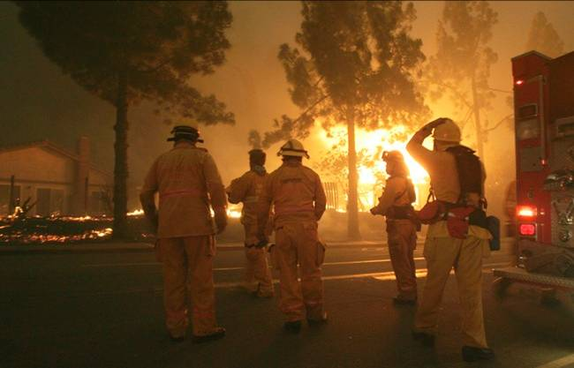
Wildland Response
RSG! Program: Fire Department & Residents working together!
60 apparatus
270 firefighters
Off duty firefighters
Reserve apparatus
Prepare your family and property
Notes:
On any given day – SDFD has 60 fire apparatus and about 270 firefighters located throughout the City.
Two-thirds of the workforce is off and can be called in, along with a fleet of reserve fire engines ready to be used.
But we’ve seen time and again, that’s not enough to protect every house. When a Santa Ana wind-driven wildfire occurs, we can’t be everywhere at once.
That’s why we advocate “Ready – Set – Go!” And the first step is to prepare – your family and your property.

Slide 6
RSG! Program – Be “Ready”, Be Firewise
Prepare For the Threat
Create a Family Disaster Plan
Prepare an emergency kit
Train your family how to use a fire extinguisher
Plan and practice different evacuation routes
Designate a meeting place outside the fire area
Maintain emergency contact numbers in
your cell phone
Notes:
“Ready”
Create a Family Disaster Plan that includes meeting locations and communication plans
Prepare an emergency kit
Train your family how to use a fire extinguisher
Plan and practice different evacuation routes
Designate a meeting place outside the fire area
Maintain a list of emergency contact numbers in your cell phone

Slide 7
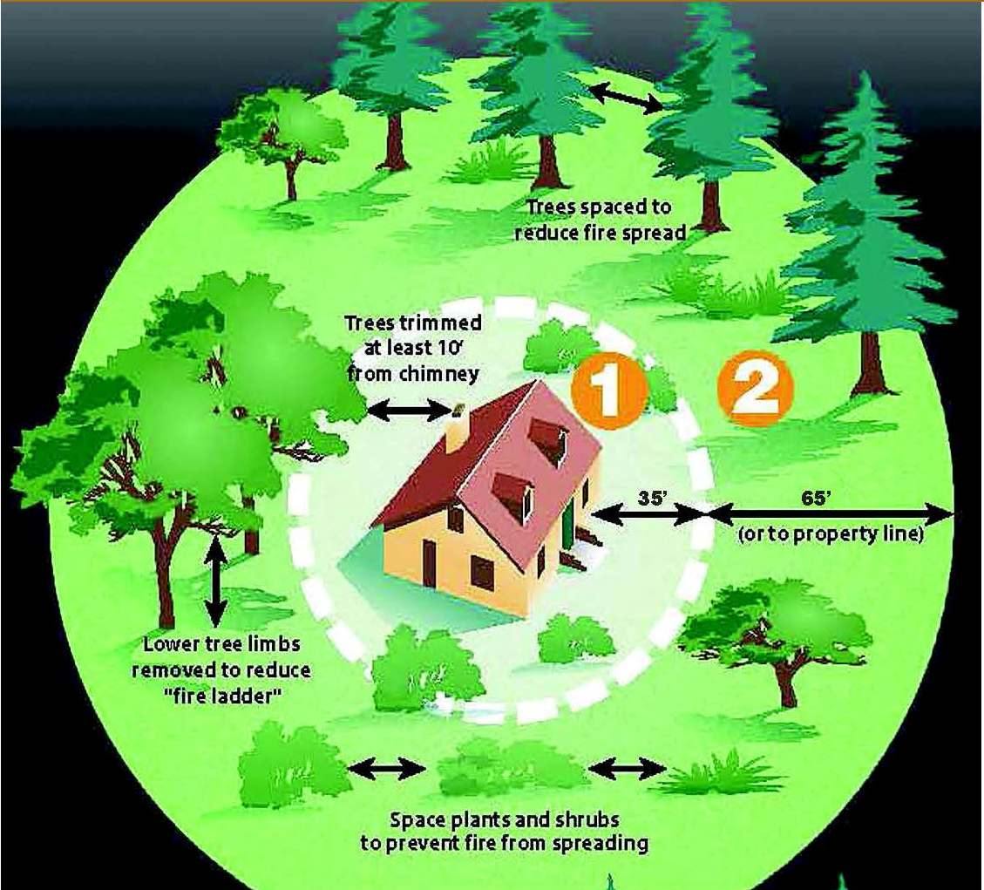
RSG! Program – Be “Ready”, Be Firewise
Defensible Space Works!
Notes:
Defensible space is the required space between a structure and the wildland area that, under normal conditions, creates a sufficient buffer to slow or halt the spread of wildland fire to a structure.
Defensible space is essential for structure survivability during wildland fire conditions.
Zone One – Extending 35 feet from your home.
• Must be permanently irrigated to maintain succulent growth,
• Is primarily low-growing plant material, with the exception of trees. Plants shall be low-fuel and fire-resistive.
• Trim tree canopies regularly to remove dead wood and keep branches a minimum of 10 feet from structures, chimney outlets and other trees.
• Remove dry leaves/pine needles from yard, roof and rain gutters.
• Relocate woodpiles and other combustible materials into Zone Two.
• Remove combustible material and vegetation from around and under decks.
• Remove or prune vegetation near windows.
• Remove “ladder fuels” (low-level vegetation that would allow the fire to spread from the ground to the tree canopy). Create a separation between low-level vegetation and tree branches by reducing the height of the vegetation and/or trimming low branches.
Zone Two extends 35 to 100 feet from your home.
• Minimize the chance of fire jumping from plant to plant by removing dead material and removing or thinning vegetation seasonally. The minimum spacing between vegetation is three times the dimension of the plant.
• There should be no permanent irrigation in Zone Two.
• Remove “ladder fuels.”
• Cut or mow annual grass down to a maximum height of 4 inches.
• Trim tree canopies regularly to keep branches a minimum of 10 feet from other trees.

Slide 8
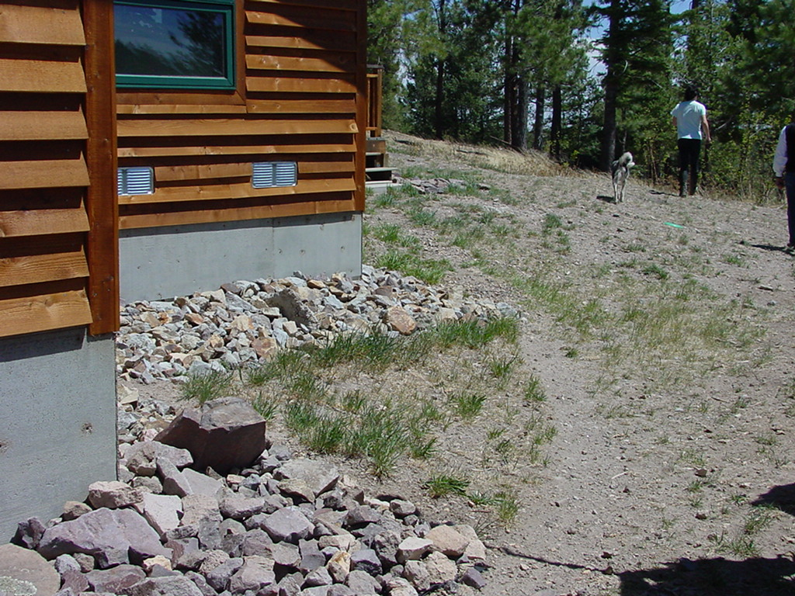
RSG! Program – Be “Ready”, Be Firewise
What you can do to make a difference:
Prepare your property by creating defensible space
Fire Harden Your
Home
Notes:
Now – when there’s no threat, you can create defensible space. – clean up or relocate combustible materials from around their home. Keep grass mowed short. Trim trees and bushes, allowing ample space between your home and landscape vegetation.
If you’re considering any remodeling – use fire resistant materials for decks and fences. Think about dual paned windows.

Slide 9
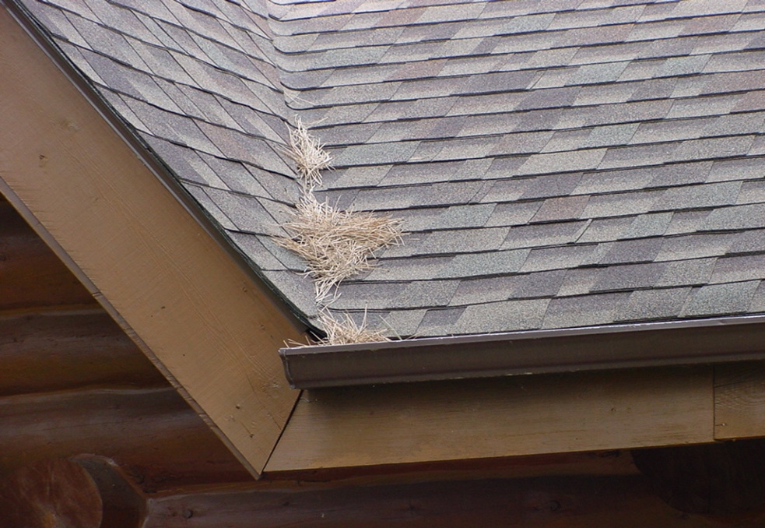
RSG! Program – Be “Ready”, Be Firewise
Consider the Ember Threat
Ember fires can destroy homes or neighborhoods far from the actual flame front
Notes:
In Santa Ana winds, embers can fly a mile or more and lodge in roof valley, under eaves or in attic vents.
Don’t give them a chance – keep dead leaves off roofs, consider boxing your eaves and be sure you have 1/8” metal mesh on your vents --- 1/8” metal – not fiberglass or plastic that can melt and burn.

Slide 10
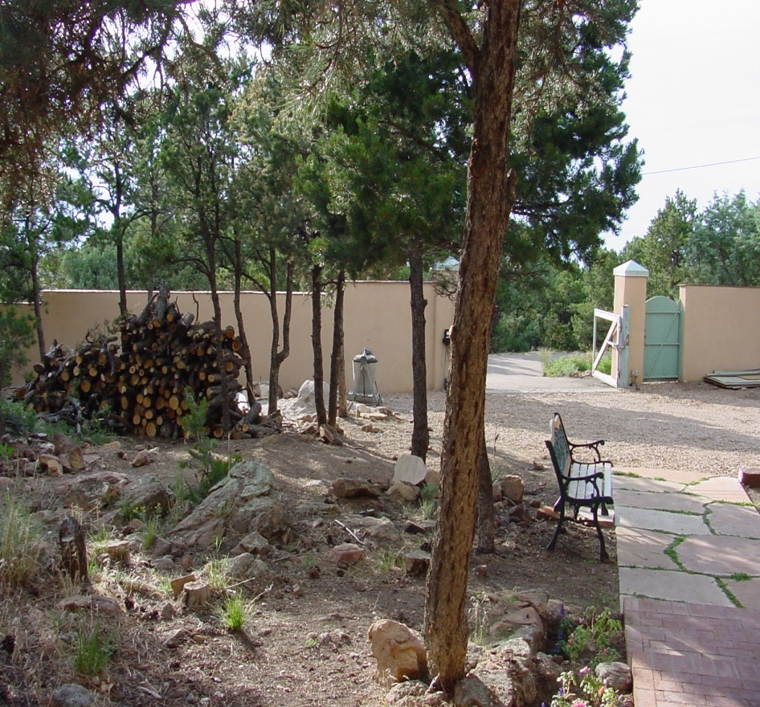
RSG! Program – Be “Ready”, Be Firewise
Firewise Strategies: Keep Radiant Heat Sources Away From the Home
Notes:
During fire season, store fire wood at least 30 feet from your house if possible.
Careful selection of fire-resistant plants can slow the spread of a wildfire and reduce its intensity.

Slide 11
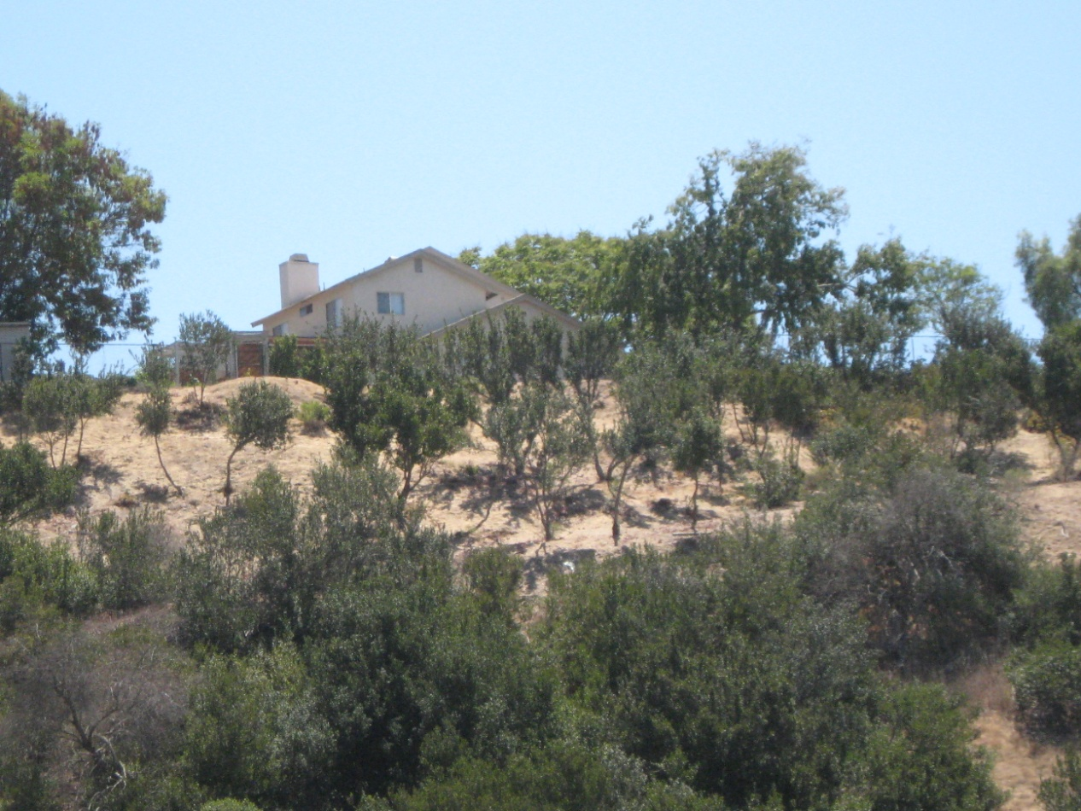
RSG! Program – Be “Ready”, Be Firewise
Maintenance is Important
Notes:
Defensible space must be maintained regularly.

Slide 12
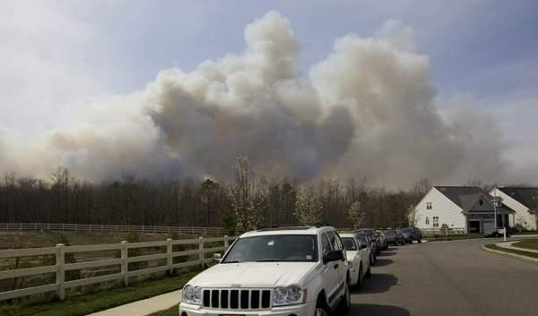
RSG! Program – Be “Set”
Situational Awareness when a Fire Starts
Local TV or radio, the Fire-Rescue Department Facebook page and Twitter feed SDFDofficial @SDFD
2-1-1
Notes:
Be aware of what is going on around you.
Keep an eye on the TV and an ear on the radio.
San Diego Fire-Rescue’s Facebook page is “SDFD Official” and our Twitter feed is “@SDFD”
And, if you have questions – call 2-1-1. We will keep 2-1-1 informed during a wildfire. Do not call 9-1-1, unless you have an emergency.

Slide 13
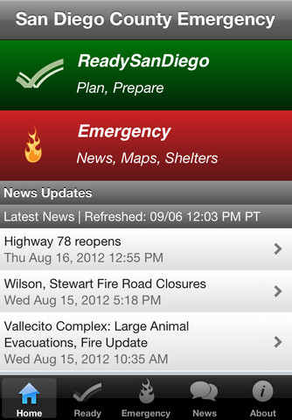
RSG! Program – Be Set
Ready San Diego
A free phone application for
disaster preparedness
City of San Diego section
http://readysandiego.org
Notes:
Ready San Diego is a free phone app
It is a free phone application for Disaster Preparedness
There is a City of San Diego section
Loaded with lots of great information for Before, During and After the disaster
http://readysandiego.org/

Slide 14
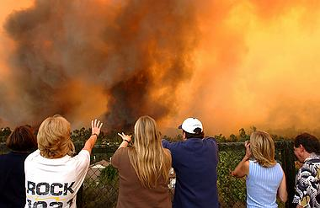
RSG! Program – Go, ACT early
Leave Early
Give your family the best chance of surviving a wildland fire
Avoid being caught in the
fire
Go to the pre-determined
meeting location
Have several routes of escape
Notes:
Go –
Don’t wait for the formal evacuation order .. Leave early
By leaving early, your give your family the best chance of surviving a wildland fire
Leave early enough to avoid being caught in the fire
Go to the pre-determined meeting location
Have several routes of escape

Slide 15
RSG! Program – Go, ACT early
Leave Early
Take your emergency supply kit
Don’t leave your pets
behind
Notes:
Go –
Don’t wait for the formal evacuation order .. Leave early
By leaving early, your give your family the best chance of surviving a wildland fire
Leave early enough to avoid being caught in the fire
Go to the pre-determined meeting location
Have several routes of escape
Take your emergency supply kit
Don’t leave your pets behind

Slide 16
RSG! Program – Local Resources
Additional Local Information
SanDiego.gov
SanDiego.gov/fire
Facebook – SDFDOfficial
Twitter - @SDFD
ReadySanDiego.gov
Notes:
I mentioned several websites – and our Facebook and Twitter.
Here are those addresses again.
You can get the Ready, Set, Go! guide on our website if you want to download it for your friends and neighbors.
I’ll leave that up there – and be glad to answer any questions.

Slide 17
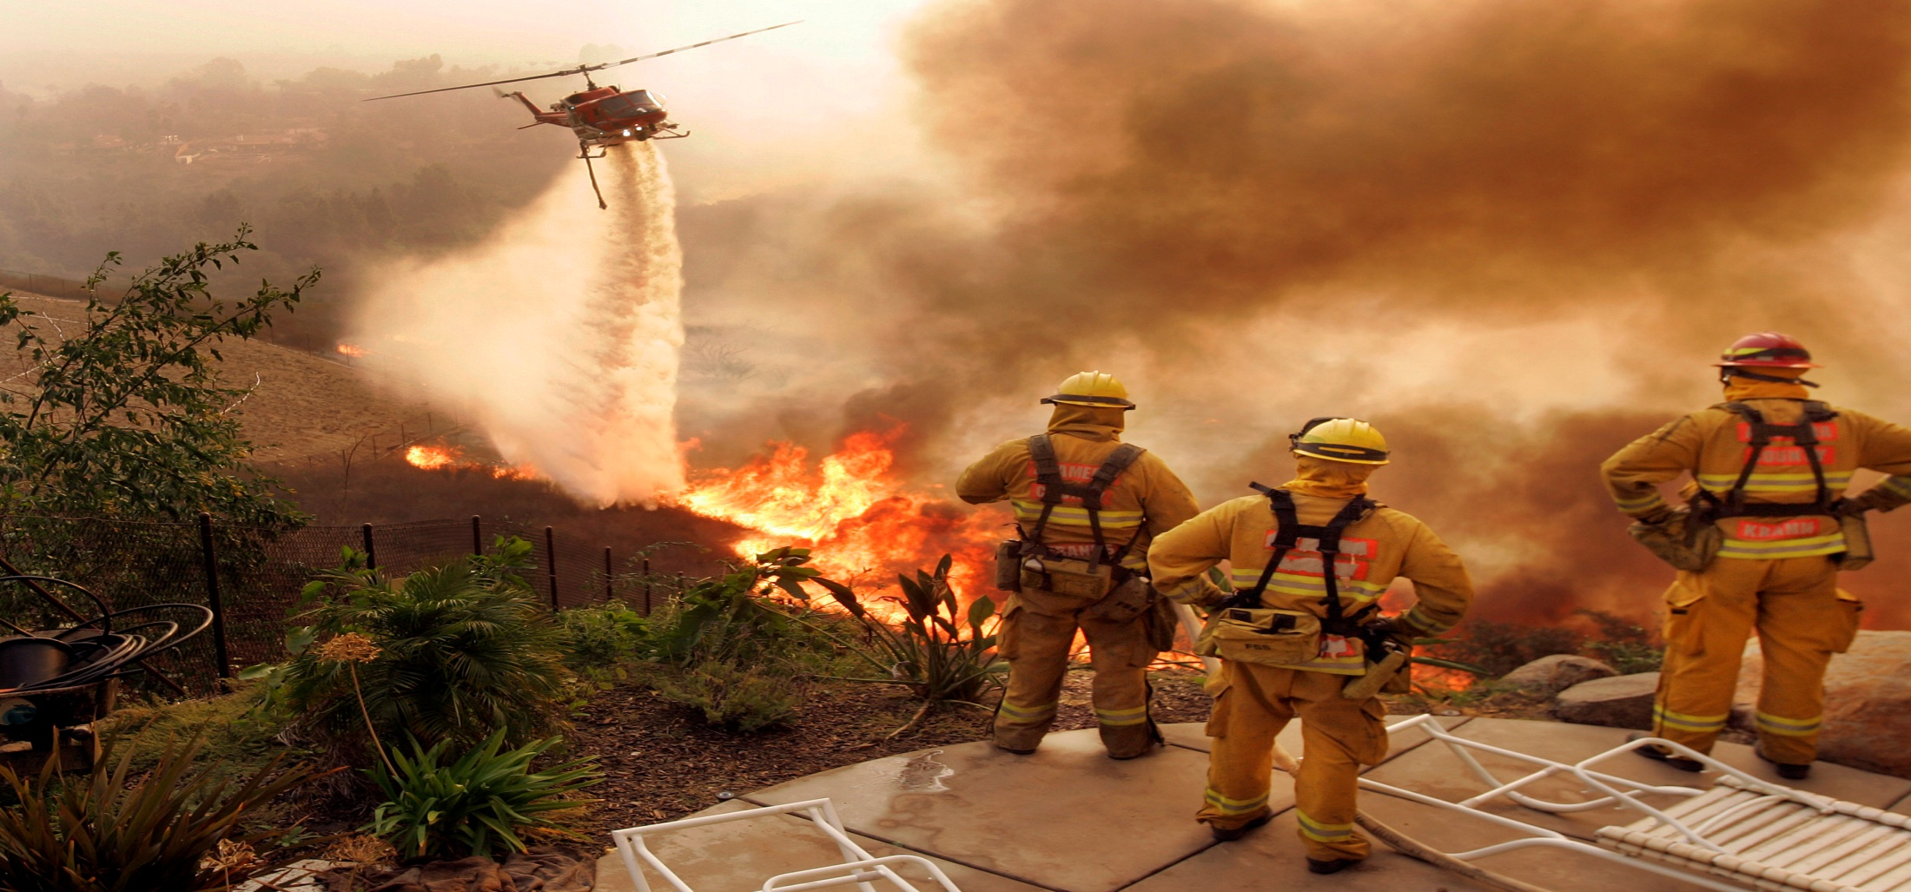
Questions and Discussion
[Insert your
Department
logo here]
Notes:
The RSG! Program implementation guide and the Your Role in Fire Adapted Communities guide can answer many questions. Feel free to contact RSG! Staff at 703.273.0911 / RSG@iafc.org if you have any questions or needs. We are happy to have you apart of the RSG! Program.

